Slide 1
Multithreading
Rajasekaran S
Assistant Professor,
Department of Information Technology,
KGiSL Institute of Technology,
email: proffraja@gmail.com
Github:www.github.com/rajasekaranap

Slide 2
Types of System
Single Processing.
Only one CPU is available.
It can run one program at a time.
Other programs must wait until CPU is released.
Multiprocessing
More than one CPU available.
It can run programs parallel.
It saves time in mutilcore processors.

Slide 3
Types of System
Single programming.
It can load and execute single program in a memory.
Other program even waits to load into memory.
Multiprogramming.
It can load more than one program into different parts of memory.
If one process waits for I/O then context switch is performed and other process is executed.

Slide 4
Types of Systems
Multitasking
Each program can have n number of task’s.
Similar to multi programming but a part of a program [task] get executed instead of whole program.
Single CPU performs multiple task based of context switching .
Task is sub unit for whole program can be compared to single thread.

Slide 5
Types of Systems
Multithreading.
It takes the advantage of multi processor systems.
A single process is executed in multiple cores in a single context.
Part’s of a program can execute concurrently in multiple cores.
Multiple Programs -> Multitasking - > Multicores

Slide 6
Threads
A thread is a lightweight sub-process, the smallest unit of processing.
Multiprocessing and multithreading, both are used to achieve multitasking.
It shares the same memory area.
Context switching between thread is faster.

Slide 7
Advantages
It doesn't block the user because threads are independent and you can perform multiple operations at the same time.
We can perform many operations together, so it saves time.
Threads are independent, so it doesn't affect other threads if an exception occurs in a single thread.

Slide 8
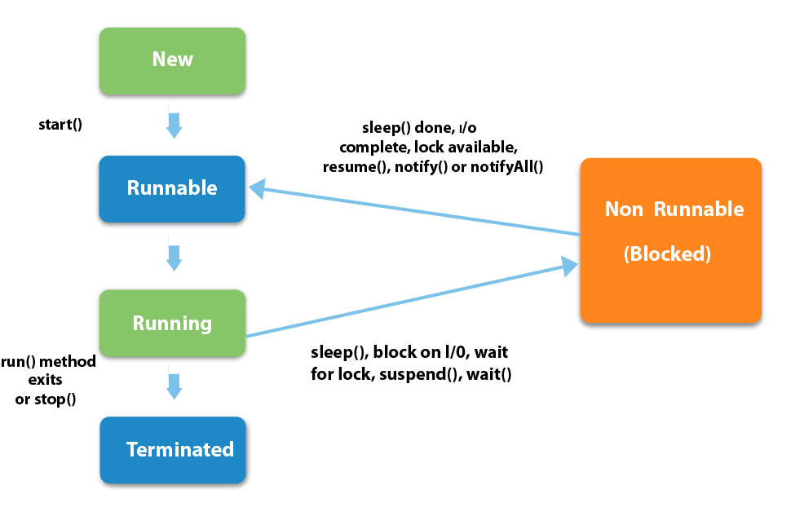
Life Cycle of Threads
Wait

Slide 9
Sates of Thread
New
The thread is in new state if you create an instance of Thread class but before the invocation of start() method.
Runnable
The thread is in runnable state after invocation of start() method, but the thread scheduler has not selected it to be the running thread.

Slide 10
Sates of Thread
Running
The thread is in running state if the thread scheduler has selected it.
Non-Runnable/Blocked/Waiting
This is the state when the thread is still alive, but is currently not eligible to run.
Terminated
A thread is in terminated or dead state when its run() method exits.
It is no longer available to execute.

Slide 11
Creating Threads in Java
A class must extend form Thread.
Override run() method of Thread class.
Create an instance for user thread class .
Call the start method to invoke the thread.
LifeCycle Methods
void start()
void run()
void wait()
void stop()

Slide 12
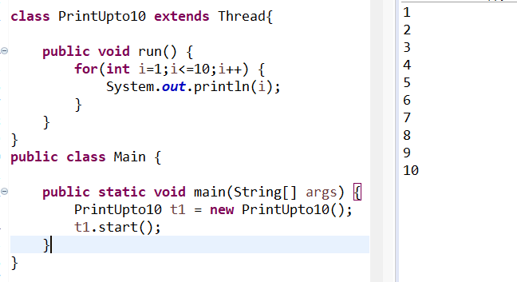
Simple Thread That Prints upto 10

Slide 13
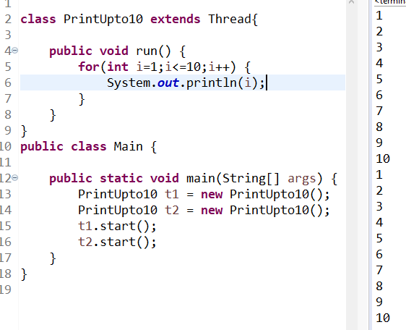
Invoking two threads

Slide 14
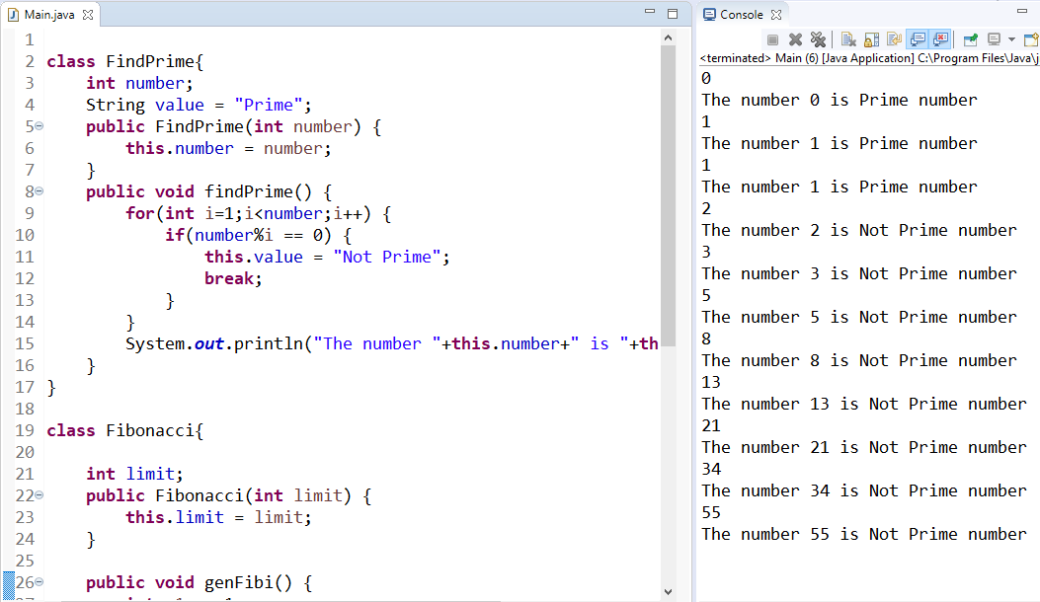
Fibonacci and Prime [Non Threading Approach]

Slide 15
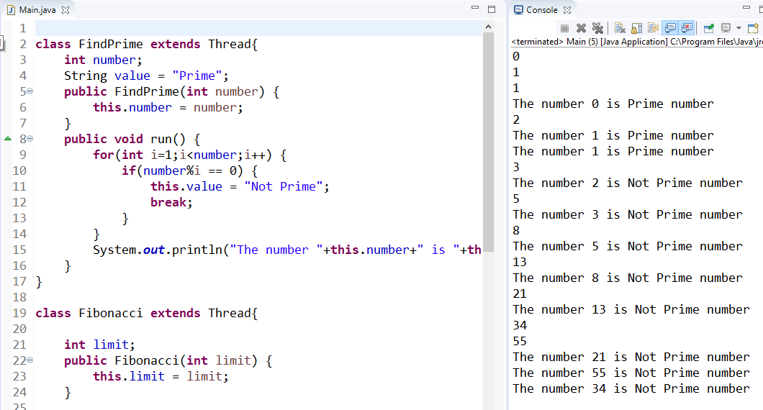
Fibonacci and Prime [Threading Approach]

Slide 16
Synchronization in Thread
Multi-threaded programs may often come to a situation where multiple threads try to access the same resources and finally produce erroneous and unforeseen results.
This is known as problem of synchronization we need take care and impose some regulation for accessing shared resource.
This situation is referred to race condition.

Slide 17
Ways to Synchronization in Java
In java synchronization is a block of code that uses the shared resources [critical part] is declared as synchronized and only one thread is allowed to access at a time.
Monitor monitors the shared resource.
If a thread need to access a shared resource first it must acquire a lock.
Then proceed to critical block execution.
Then releases the lock and allows other thread to acquire a lock .

Slide 18
Types of Synchronization
Mutual Exclusion
Synchronized Methods.
Synchronized Block.
Static Synchronization.
Cooperation
Inter thread communication

Slide 19
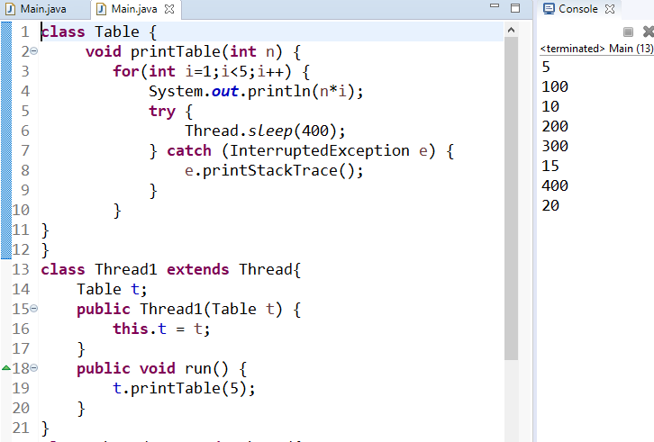
Process without Synchronization

Slide 20
Non Synchronized Table Printing
Printing5th Table
run()
shared
Table
Main
printTable()
main()
shared
Printing100th Table
Non synchronized
run()

Slide 21
Synchronized Method
A method that is shared among the threads need’s to be declared as synchronized.
Syntax
Synchronized return_type method_name(args){
//block of code
}

Slide 22
Cooperative Threads
Two threads responsible for completing one process.
Two threads must co-operate with each other to avoid race conditions.
Inter thread communication is a key to achieve this.
Eg:
Producer Consumer Problem [Bounded Buffer Problem]

Slide 23
Producer Consumer Problem [Bounded Buffer Problem]
Here producer produces element’s and stored in buffer [it is bounded or has limit for no of elements to be stored].
Consumer consumes the elements produced by producer and removes the elements from the buffer.
This process till continues as long as produces puts the element on time and consumer consumes elements on time.

Slide 24
Producer Consumer Problem [Bounded Buffer Problem]
In reality producer may cause some delay to produce in that situation if buffer is empty then consumer must wait.
Some times consumer may cause delay to consume the elements in that case if buffer is full then producer must wait.

Slide 25
Without Communication
There is no element to consume
1
2
PRODUCER
CONSUMER

Slide 26
Producer Produces
1
Wait
PRODUCER
CONSUMER
1
2
Wait
PRODUCER
CONSUMER
1
2
3
Wait
PRODUCER
CONSUMER
1
2
3
4
Wait
PRODUCER
CONSUMER

Slide 27
Consumer Consumes
Wait
1
2
3
4
PRODUCER
CONSUMER
Wait
2
3
4
PRODUCER
CONSUMER
Wait
3
4
PRODUCER
CONSUMER
Wait
4
PRODUCER
CONSUMER

Slide 28
Demo
https://github.com/rajasekaranap/CS8392-Workspace/tree/master/U4-ProduserConsumerWithSync

Slide 29
Demon Thread
Daemon thread in java is a service provider thread that provides services to the user thread.
It provides services to user threads for background supporting tasks. It has no role in life than to serve user threads.
Its life depends on user threads.
It is a low priority thread.

Slide 30
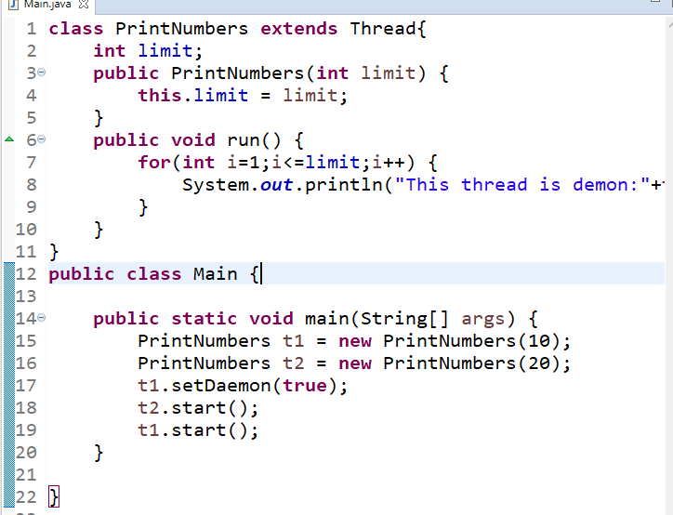
Demon Thread Demo

Slide 31
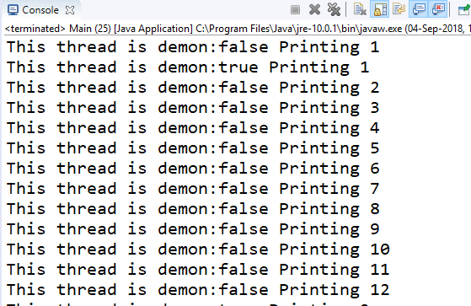
Output

Slide 32
Thank You
Rajasekaran S
Assistant Professor,
Department of Information Technology,
KGiSL Institute of Technology,
email: proffraja@gmail.com
Github:www.github.com/rajasekaranap

